Slide 1

Network Anomaly Detection in Cloud-based Management Services using AI
SALVIN THILAK SADASIVAN – 1270667
MABHARA TINEYI - 1270667
(Group No.: 38)

Slide 2
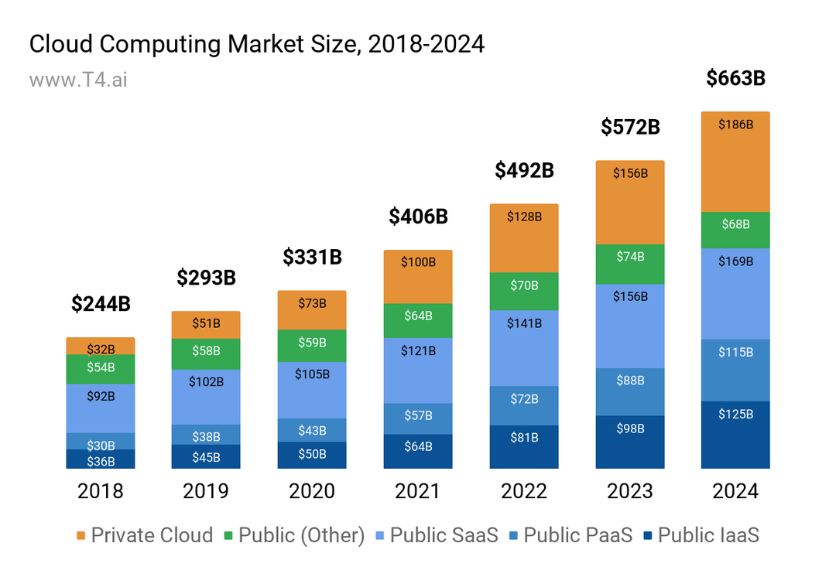

Slide 3



The Dawn of Artificial Intelligence

Slide 4


Slide 5


Let’s First understand what Anomaly detection is
A
B
C
D
Manufacturing - Quality Control
It identifies defective products or those that deviate from the expected standards.

Slide 6

What is anomaly detection?
Anomaly detection is the process of identifying data points, events or patterns in a dataset that deviate significantly from the expected behaviour or norm.
These “anomalies” or “outliers” can indicate important insights such as errors, fraudulent activities, system failures or unexpected trends in data.
source: chatGPT

Slide 7
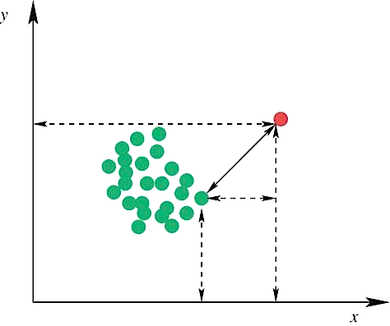
Traditional Anomaly Detection
Statistical methods: Using statistical techniques like z-scores, Mahalanobis distance, and isolation forests to identify outliers.
Machine learning: Using algorithms like support vector machines, decision trees, and neural networks to learn normal patterns in data and identify deviations.
Time series analysis: Using techniques like ARIMA and LSTM to identify anomalies in time series data.
outliers

Slide 8
Real-life examples of anomaly detection
Fraud detection
Network intrusion detection
Healthcare
Manufacturing industry
Customer churn prediction
Machine maintenance
Identifying unusual credit card transactions, such as large purchases in unfamiliar locations or multiple transactions within a short period.
Detecting suspicious network activity, such as unauthorized access attempts or malicious traffic.
Detecting unusual patient vital signs or symptoms that may indicate a serious health condition.
Identifying defective products or processes that deviate from the expected standards.
Predicting which customers are likely to stop using a product or service.
Predicting equipment failures based on sensor data.

Slide 9




Slide 10


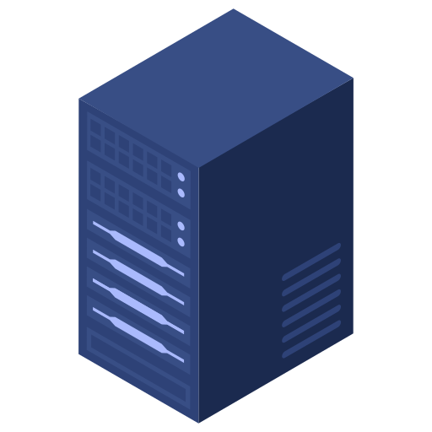


With the rapid growth of IoT and cloud computing, real-time network traffic analysis for detecting anomalies has become critical. Existing systems face challenges such as high computational complexity and high false-positive rates.
Cloud
Client A
Client E
Client B
Client C
Client D
Local Network ( Institution / MNCs )

Slide 11

Data
MIRRORING
Cloud
END USER
A
B
ANOMALY DETECTION
ROUTER
LOCAL SERVER
Data mirroring is a technique used in cloud computing and other distributed systems to replicate data across multiple locations or devices. This redundancy ensures that if one location fails, the data can still be accessed from another.

Slide 12
Data mirroring can be a valuable tool for anomaly detection in cloud computing environments. Here's how:
Comparison of mirrored data: By comparing the data stored on mirrored servers or storage devices, anomalies can be identified. If there are inconsistencies between the copies, it may indicate a problem, such as data corruption or unauthorized access.
Real-time monitoring: Mirrored data can be monitored in real-time to detect anomalies as they occur. This can help to prevent data loss or other negative consequences.
Correlation with other metrics: Data mirroring can be combined with other monitoring techniques, such as network traffic analysis or server performance monitoring, to identify the root cause of anomalies.
Anomaly Detection Using Data Mirroring

Slide 13

Challenges in anomaly detection
Defining normality: Determining what constitutes a normal pattern can be challenging, especially in complex datasets.
Class imbalance: In many cases, anomalies are rare events, leading to imbalanced datasets that can bias the detection process.
Noise: Noise in the data can make it difficult to accurately identify anomalies.
Novelty: Detecting new types of anomalies that have not been seen before can be challenging.

Slide 14

Possible Solutions
A hybrid model leveraging an improved version of GWO (ImGWO) for feature selection and CNN (ImCNN) for classification. ImGWO optimizes the selection of features, while ImCNN enhances classification accuracy using a refined dropout function to prevent overfitting.
In the first phase, ImGWO is used for feature selection in order to obtain an optimal trade-off between two objectives, i.e., reduced error rate and feature-set minimization. In the second phase, ImCNN is used for network anomaly classification.

Slide 15
imGWO
imCNN
imGWO stands for Improved Grey Wolf Optimizer. It's a metaheuristic optimization algorithm inspired by the hunting behaviour of grey wolves. The original Grey Wolf Optimizer (GWO) algorithm has been enhanced in several ways to improve its performance and efficiency, resulting in the imGWO.
Enhanced search mechanism: imGWO often incorporates techniques to improve the exploration and exploitation capabilities of the algorithm, leading to better solutions.
Improved convergence: Modifications to the GWO algorithm can help it converge more quickly to optimal or near-optimal solutions.
Enhanced adaptability: imGWO might be more adaptable to different problem domains or have better performance on specific types of optimization problems.
"imCNN" might be a custom or modified version of a Convolutional Neural Network (CNN) specifically designed for anomaly detection.
An imCNN could incorporate various techniques to enhance its ability to identify anomalies in data. These techniques might include:
Specialized architectures: Architectures that are more suited for anomaly detection tasks, such as using autoencoders or generative adversarial networks (GANs).
Loss functions: Custom loss functions that prioritize the detection of outliers or anomalies.
Data preprocessing: Techniques to handle noisy or missing data, and to normalize the data for better performance.
Feature engineering: Creating new features or transforming existing features to improve the CNN's ability to detect anomalies.

Slide 16
Libraries used:
TensorFlow for Anomaly Detection
TensorFlow is particularly well-suited for deep learning models, which can be highly effective for complex anomaly detection tasks.
Autoencoders:
Train an autoencoder to reconstruct normal data points.
Anomalies will have significantly higher reconstruction errors.
One-Class SVM:
While not strictly deep learning, TensorFlow can be used to implement one-class SVMs, which learn a boundary around normal data points.
Points outside this boundary are considered anomalies.
Generative Adversarial Networks (GANs):
Train a GAN to generate normal data points.
Anomalies will be those that the GAN cannot generate or poorly reconstructs.

Slide 17
Libraries used:
Scikit-learn for Anomaly Detection
Scikit-learn provides a variety of algorithms specifically designed for anomaly detection.
Isolation Forest:
Isolates anomalies by randomly selecting features and splitting data, assuming anomalies will be isolated quickly.
Local Outlier Factor (LOF):
Measures the local density deviation of a point compared to its neighbors.
One-Class SVM:
As mentioned earlier, can also be implemented using Scikit-learn.

Slide 18

Benefits of AI-Driven Anomaly Detection

Slide 19

Improved Accuracy: AI models can often outperform traditional methods in detecting anomalies, leading to more accurate and reliable results.
Faster Response Times: AI can detect anomalies in real-time, enabling faster response and mitigation.
Optimized Resource Allocation: AI-driven resource allocation can reduce costs and improve efficiency.
Scalability: AI systems can handle large volumes of data and complex network environments.
By effectively implementing AI into your anomaly detection system, you can significantly improve resource allocation, enhance performance, and strengthen your organization's security posture.

Slide 20

Thank You

Slide 21

References
Cloud computing market share, market size AND industry growth drivers, 2018 - 2024 -https://www.t4.ai/industry/cloud-computing-market-share
IEEE Transactions On Network And Service Management, Vol. 16, No. 3, September 2019
https://techcommunity.microsoft.com/t5/azure-data-explorer-blog/multivariate-anomaly-detection-in-azure-data-explorer/ba-p/3689616
Deep Learning - https://www.deeplearningbook.org/
DeepWindow: An Efficient Method for Online Network Traffic Anomaly Detection - https://ieeexplore.ieee.org/document/8855360
Network Anomaly Detection: Methods, Systems and Tools - https://ieeexplore.ieee.org/abstract/document/6524462
Optimizing Resource Allocation in Cloud Infrastructure through AI Automation: A Comparative Study - Journal of Knowledge Learning and Science Technology ISSN 2959-6386

